Slide 1
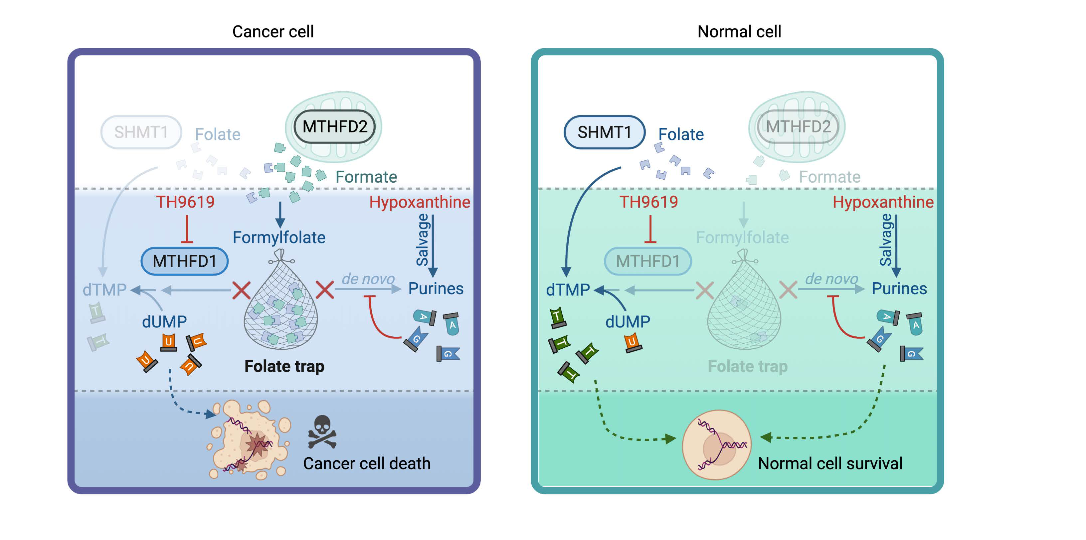
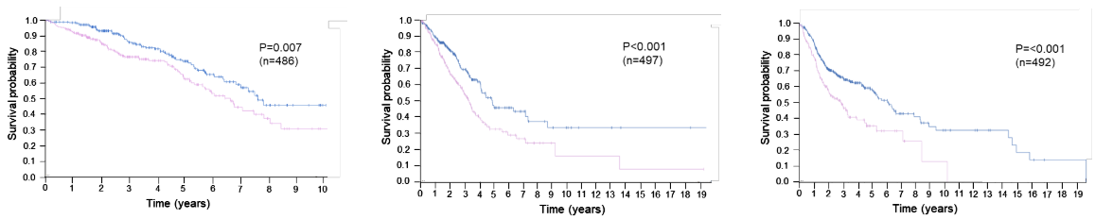
A Phase 1/2 First-in-Human Study of TH9619
in Patients With Advanced Refractory Solid Tumours (ODIN)
TPS3165
V MORENO¹, A HOLLEBECQUE², I BRAÑA³, A STONE⁴, V MOODY⁵, T HELLEDAY^{5,6}, E EHRNROOTH⁵, R PLUMMER⁷
Copies of this poster obtained through QR Code are for personal use only and may not be reproduced without permission from ASCO® or the authors.
¹START Madrid-FJD, Hospital Fundación Jiménez Díaz , Madrid, Spain; ²Institut Gustave Roussy, Villejuif, France; ³VHIO/Hospital Universitari Vall d'Hebron, Barcelona, Spain; ⁴Independent Biostatistics; ⁵One-carbon Therapeutics AB, Solna, Sweden; ⁶Karolinska Institutet, Solna, Sweden ⁷Newcastle University Centre for Cancer, UK
BACKGROUND & RATIONALE:
TH9619 MECHANISM OF ACTION
Cancer cells depend on one-carbon metabolism to sustain rapid DNA synthesis and survival. Two key enzymes in this pathway - MTHFD1 (cytoplasmic) and MTHFD2 (mitochondrial/nuclear) - are highly and consistently overexpressed in solid tumours compared to normal tissues.^{1,2} This creates a cancer-specific dependency that TH9619 is designed to exploit with high selectivity.
MTHFD2 is one of the most overexpressed genes in cancer¹ and consistently associated with significantly worse overall survival across multiple cancers.^{1,2}
This supports MTHFD1/2 as actionable therapeutic targets in the refractory tumor settings.
TH9619 is a first-in-class potent small molecule MTHFD1/2 inhibitor (intravenous administration), that selectively kills cancer through folate trapping.^{3,5}
In cancer cells, high MTHFD2 expression drives the release of formate from mitochondria into the cytosol, to generate 10-CHO-THF (formylfolate).
Inhibition of MTHFD1 by TH9619 prevents further use of 10-CHO-THF for downstream thymidylate synthesis.
This creates a folate trap, depleting the folate (THF) necessary for thymidylate production, resulting in nucleotide shortage, DNA damage, and cancer cell death.
Normal cells lack MTHFD2 expression and the formate overflow needed to create this trap.
Colon adenocarcinoma
Lung adenocarcinoma
Head & Neck
squamous cell carcinoma
P=0.007
(n=486)
P<0.001
(n=497)
P≤0.001
(n=492)
Figure legend: Proposed mechanism of action of TH9619. Selective MTHFD1/2 inhibition disrupts one-carbon metabolism in cancer cells while sparing normal cells that rely on SHMT1 and salvage pathways. Adapted from Bonagas et al., Nature Cancer 2022³.
Created with BioRender.com.
High MTHFD2 expression
Low MTHFD2 expression
Figure legend: Kaplan-Meier survival analysis of MTHFD2 mRNA expression across three solid tumor types from TCGA cohorts. High MTHFD2 expression is associated with significantly worse overall survival in all three indications (P≤0.007).²
ODIN STUDY DESIGN — NCT07151040
Flexible study design allowing for early signal detection⁶
PHASE 1A Dose escalation (N up to 80) |  | PHASE 1B Expansion (N up to 60) | PHASE 2 (N up to 200)
KEY ELIGIBILITY CRITERIA Histopathologically confirmed advanced cancer Indications in focus: NSCLC, HNSCC, CRC, GC, GEJC Prior treatment with at least one line of cytotoxic systemic therapy for metastatic and/or unresectable cancer Adult patients (≥18 years of age) Must be willing to comply with study procedures No history or presence of any clinically significant disorders as judged by the Investigator | STUDY TREATMENT TH9619 i.v. Starting dose 500 mg/m² 28-day cycle until disease progression and/or unacceptable toxicities | Pick the best indication(s) Confirm signal from Phase 1a | Specifics about trial design under discussion
STUDY SITES
🇬🇧 United Kingdom
1. Northern Centre for Cancer Care, Newcastle
🇫🇷 France
2. Institut Gustave Roussy, Villejuif
🇪🇸 Spain
3. START Madrid – FJD;
4. Hospital Universitari Vall d'Hebron, Barcelona
PRECLINICAL DATA
OBJECTIVES & ENDPOINTS & KEY ELIGIBILITY CRITERIA— PHASE 1
OVERALL STUDY STATUS
TH9619 is a small molecule inhibitor with high selectivity and nM potency designed to increase cancer specificity.^{3,4}
Primary objectives:
To assess the safety, tolerability and MTD and recommended dose(s)) of TH9619 as monotherapy in patients with selected solid tumors
Key Endpoints of the Phase 1a:
Primary endpoints: frequency, severity and causality of adverse events; tolerability of TH9619
Secondary endpoints: pharmacokinetics, antitumor activity/efficacy per RECIST 1.1 (such as ORR, DoR, PFS)
Exploratory: ctDNA and biomarkers
Study initiated (first patient dosed) in September 2025
Dose escalation is ongoing
4 active sites in UK, France, Spain
European site expansion planned
Clinical data expected to be published in 2027
Biomarkers being explored in parallel
SINGLE-AGENT EFFICACY: Demonstrated in CRC and NSCLC in vivo models
OUTPERFORMS SoC and active in SoC-resistant lines
POTENT TUMOR KILLING in patient-derived organoids while sparing normal tissue vs SoC
FAVORABLE THERAPEUTIC INDEX versus SoC
FAVORABLE TOX PROFILE: No MTD reached in GLP toxicology studies (dog)
nM POTENCY: MTHFD2 IC₅₀ = 47 nM | MTHFD1 IC₅₀ = 16 nM
NOTES
ABBREVIATIONS
Acknowledgements: This study is funded and conducted by One-carbon Therapeutics AB.
Lead Author Disclosures Victor Moreno: Employee of START. Consulting fees from: Abbvie, Roche, Bayer, BMS, Janssen, Syneos, Affimed, Astra Zeneca,Merck, Ellipses Pharma. Pharmamar, ViroFend, Miltenyi, Pan-Cancer T Contact details for presenting author: victor.moreno@startmadrid.com
References: 1. Nilsson R et al. Nature Communications 2014; 5:3128; 2. Adapted from The Human Protein Atlas (proteinatlas.org), Pathology Atlas. Survival analysis based on TCGA data; 3. Bonagas et al. Nature Cancer 2022; 3;156-172; 4. Gustafsson R et al. Cancer Research 2017; 77:937–948; 5. Green et al. Nature Metabolism 2023; 5(4):642-659; 6. CT.gov ID NCT07151040
CRC, colorectal cancer; ctDNA, circulating tumor DNA; DNA, deoxyribonucleic acid; DoR, duration of response; ECOG PS, Eastern Cooperative Oncology Group Performance Status; GC, gastric cancer; GEJC, gastroesophageal junction cancer; GLP, Good Laboratory Practice; HNSCC, head and neck squamous cell carcinoma; IC₅₀, half-maximal inhibitory concentration; i.v., intravenous; MTD, maximum tolerated dose; MTHFD1/2, methylenetetrahydrofolate dehydrogenase 1/2; N, number of patients; nM, nanomolar; NSCLC, non-small cell lung cancer; ODIN, study name; ORR, objective response rate; PK, pharmacokinetics; RECIST 1.1, Response Evaluation Criteria version 1.1; SHMT1, serine hydroxymethyltransferase 1; SoC, standard of care; THF, tetrahydrofolate
TPS3165 | POSTER SESSION – DEVELOPMENTAL THERAPEUTICS: MOLECULARLY TARGETED AGENTS & TUMOR BIOLOGY
MAY 30TH, 2026 | 1:30–4:30 PM CDT | BOARD 297A

